Slide 1
Customer and Partner Lifecycle Management (CPLM) From Onboarding to Renewal
Owning and Optimizing End-to-End Lifecycle Management for Predictable Revenue Growth

Slide 2
Business Challenges in Hi-Tech Industry
Business Challenge 1
Business Challenge 2
Description
Description
Business Challenge 3
Business Challenge 4
Description
Description

Slide 3
Offering Overview

Slide 4
Offering Architecture

Slide 5






ZenseAI.Data Reference Architecture
Optimization through our connected intelligence AI Accelerators
Zensar Buddies
Domain agents
Third party agents
Ai engg buddy
Data Buddy
Action
Agent builder
Agent orchestration
Agent observability
Agent library
Guards and
governance
Prompt/Persona
builder
Mutli Agent
coordinator
Task planner/ splitter
LLM
Routers
Cost/
Token tracker
Event logger/
tracker
Prompt & Chain templates
RBAC
Integrators &
connectors
State Machine Manager
Context cache
Performance monitor
Versioning
Authorization
and authentication
Search
ZenseAI
Unified AI powered hybrid search (semantic, contextual, multimodal) / NL conversational engine
Prompt
Guards
Advanced Search/RAG Engine
Dynamic knowledge graph
(entity linker and disambiguator
Relation inferencer
Semantic retriever
Hybrid search and weighted ranking
RAG query writer
LLM
Deployment
agent
Knowledge: Connected Intelligence & Human like understanding
An AI-powered accelerator platform that unifies fragmented data, builds connected intelligence, and delivers real-time, personalized insights through secure, ready-to-deploy AI agents.
Customize as per the environment enable quick deployment.
Automated AI extractors/processors/enrichers-
Domain metadata, semantics
Integrated workspace –
Documents, codes, tickets
Software health metrics
Audit logs
AI First Contextual linkages – classify, pre-process,
Synthesize, summarize, enrich
Centralized knowledge
Debt Classification,
& Insights
Model
finetuning
E2E dependency graphs
Connectors
Actions
Multiple internal systems (CRM, Wealth, SME, transaction data, content repositories)
External APIs, market data, social feeds
Deployment
Model library
(SLM/Private LLM)
Data center
GPU/
CPU

Slide 6

ZenseAI.Data to automate and optimize Data Engineering tasks
Unified Data
AI@Core
Intelligent Operations
AI-Infused Data Engineering
AI-Infused Data Insights
AI-Driven Data Governance
AI Enabled Data AMS
Agentic Pipelines
Metadata Sentinel
Pipeline Validator Agent
Auto Data Visualizer
Narrative Insights
Agentic AI Metadata Enrichment
Smart Ticket Assignment
Ticket Volume Forecast
Mask Agent
DQ Agent
Model IQ Agent
Report Usage Agent
Report Migrator Agent
Tokenization & Classification Agent
Ticket Similarity Engine
History Flow Agent
Archive Agent
Data Profiler
Reporting Hub IQ
Data Security Agent
Data Catalog IQ
Knowledge Management
Data Secure IQ
Agentic Lineage
Annotation Agent
SLA Breach Propensity
Data Observability
Foundation Modules
Agentic AI Metadata Enrichment
Agentic AI Data Explorer
Data Quality
Knowledge Curation
Tech Modernizer
Code Management
Synthetic Data Generator
Frameworks
Data & Analytics Maturity Framework
Responsible AI
Report / ETL Rationalization
Migration Framework
Cloud Evaluation
Agentic Automation
Cloud Modernization

Slide 7
Business value for clients
Benefit 1
Intelligent Operations
+
Artificial Intelligence
+
Unified Data
Benefit 2
Benefit 3
Benefit 4

Slide 8
Success Stories

Slide 9


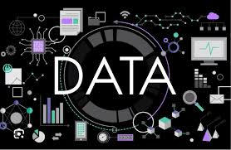
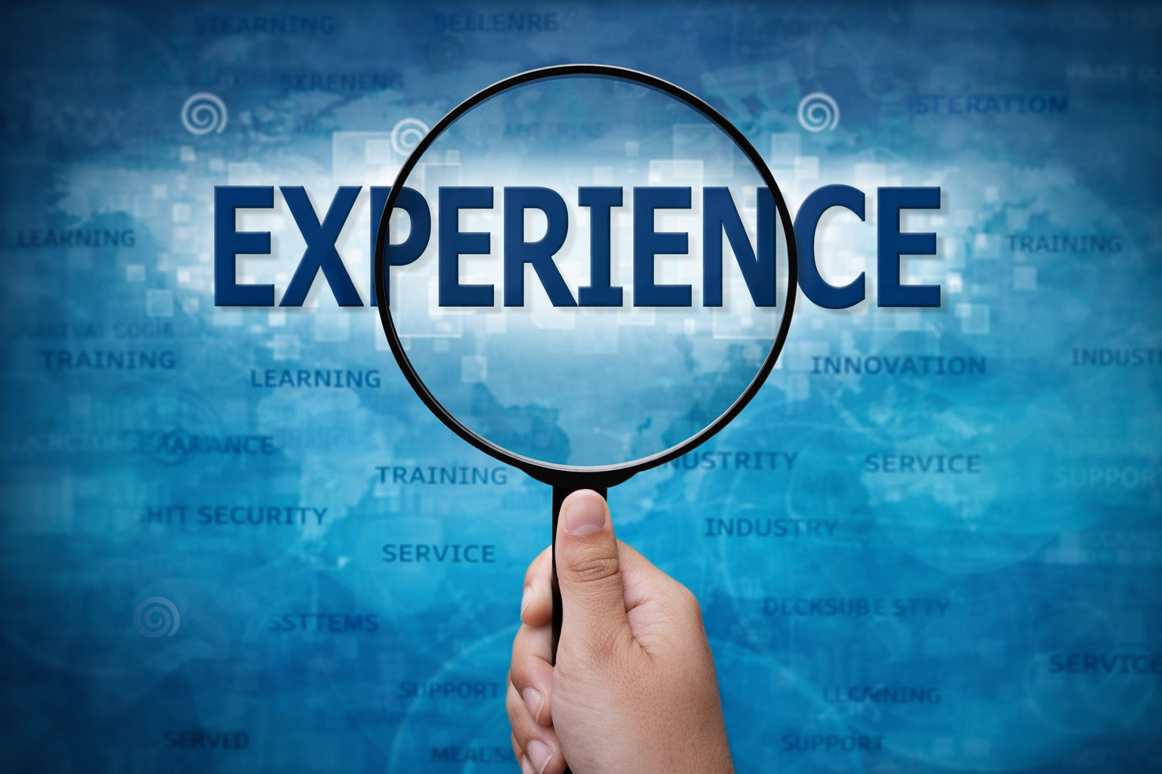
Value delivered to clients globally
Success Story 2
Success Story 4
Client 1
Client 3
Success Story 3
Success Story 1
Client 2
Client 4

Slide 10

















Zensar Capabilities
2500+
50%+
20%+
60+
Experience, Digital, and Data Associates
Delivering Solutions through AI-infusion
Zensar’s revenue from Hi-Tech clients
Global Hi-Tech Clients
Deep Expertise
Scalable Automation
Partner Impact
AI Driven
Revenue
Hi-Tech Client portfolio:
Supply Chain Management
Software / ISVs
Networking / OEMs
Semiconductors
Hyperscalers
Drive efficiency through intelligent process automation
End-to-End Orchestration
Human-in-the-Loop
Rapid Scaling
Facilitate a win-win partner business framework
Faster Onboarding
Whitespace identification
Training and Certification
AI at the core of Lifecycle Transformation
Predictive Analytics
Sentiment to Churn Correlation
Automation
Driving growth through data-driven lifecycle strategies
Pipeline Acceleration
Cross-Sell enhancement
Retention Uplift
Proven CPLM Transformation Partner | AI-First Approach | Demonstrated Global Impact | Deep Partner Ecosystem Expertise | Ready-to-Deploy Accelerators

Slide 11
Next Steps
DISCOVERY WORKSHOP
DELIVERABLES & VALUE
WHY ACT NOW
Business Perception
Accelerate time-to-value with ready-to-deploy accelerators
Insights with 10-15% revenue growth potential
Position your business as a Top Partmer in a rapidly evolving landscape
2 - 3 Weeks
Flow Mapping
Designed for speed without compromising depth
AI Maturity Assessment
Monetization Model Validation
Week 1
Week 2
Week 3
Value Development
KPI Assessment
Let’s schedule your Discovery Workshop today and co-create a transformation roadmap driving measurable impact within next quarter

Slide 12




Thank You!
www.zensar.com | ©

